Slide 1

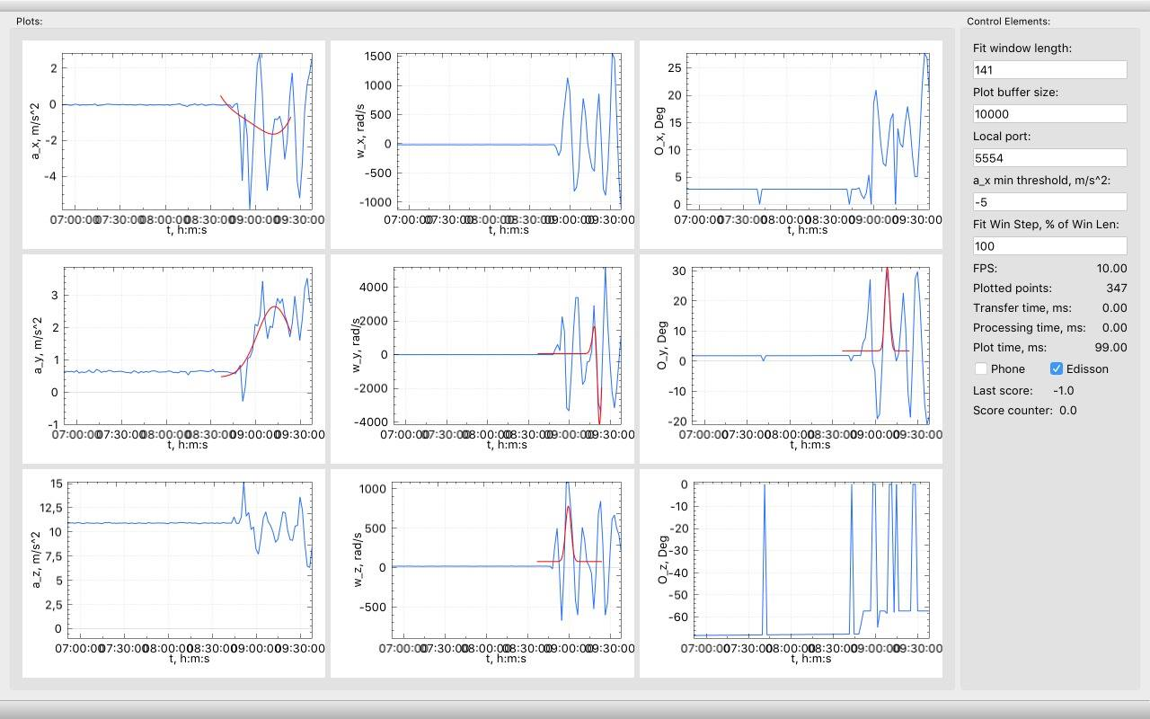
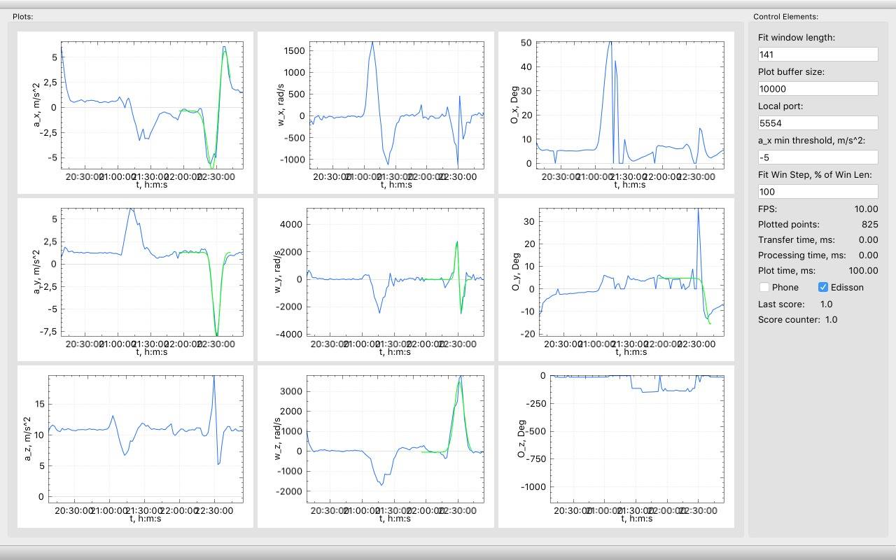
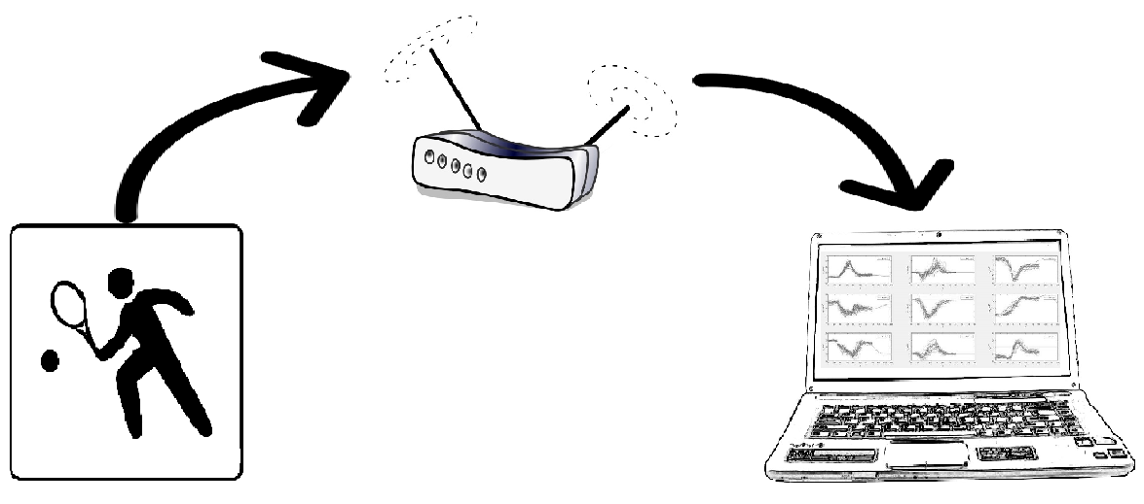
Tennis gets smart: Machine Learning Based Tennis Personal Coach
Alexander Kozhinov Suresh Dharani Parasuraman Amir Kallel
Advisor: Sebastian Böttcher Embedded Systems Chair, Faculty of Engineering, University of Freiburg
Introduction
Results
Tennis is a fun game to play, however quite difficult to get better at it: a Tennis club membership is usually the only option for ambitious players who want to level up their game. This comes with a big cost and time commitment.
Fortunately, a smart racket may replace the effort of a personal trainer at the club as well was the pricey bill that follows.
The project is an alternative of a personal coach while training, where it guides the player via live feedback of his tennis moves in order to develop a proper technique.
Server side application receiving data, plotting them and predicting goodness of swings based on the training set already provided:
Hardware Setup
Data plotted and predicted correctly as a wrong swing move
Client Side
Server Side
Data plotted and predicted correctly as a correct swing move
9-axix MPU-9150™ [Gyroscope / Compass / Accelerometer]
Intel Edison module Broadcasts senor data
Live data plotting
On-the-fly classification of data to detect swings
Display game statistics
Future Work
Theory & Methods
The challenge addressed in this project revolves around reducing the dimensionality of the classification problem: algorithm was used to easilly classify 26 features of gaussian distribution models representing 5 sensor data channels. The system can be improved through the following:
Record more data for the training set for better swing prediction accuracy.
Train a classifier with nonlinear characteristics.
Better signal filtering.
Train the system automatically while playing.
Compare swing quality in comparison to the training set.
Provide live feedback along with game statistics and estimated calories burned through a smartwatch
Sensor data streams were recorded while performing 93 tennis swings. 5 out of 9 sensor data channels were modeled using 1st and 2nd gaussian distributions. The models have served as a training set for a classifier using the Linear Discriminant Analysis (LDA) algorithm.
Once the classifier is defined, the player may play and track his movements through the 9 sensors‘ data feed plotted live. The classifier predicts on the fly whether a swing has taken place or not.

